Slide 1

DIABETES PREDICTION USING MACHINE LEARNING TECHNIQUES Final year project Review-2 Batch – (2019-2023) Group Members : Abhay Kumar, Sungjemkaba Reg_no : 2019105194, 2019105219 28-sep-2022
Department of Computer Science and Engineering
National Institute of Technology Nagaland

Slide 2
Contents
Glimpse of previous review
Flow diagram
Proposed model
Diabetes dataset
Data pre processing
Correlation

Slide 3
Glimpse of previous review
Diabetes is the fastest growing chronic disease in the world according to world health organization data 537 million people suffering from diabetes and this data is increasing day by day.
Diabetes prediction model can be used in the medical field.
Going through the literature on diabetes prediction using machine learning techniques , it has been found that using data pre-processing and balancing the dataset the accuracy may be increased.
Objective of the project is to develop a model which can predict the diabetes.

Slide 4
Flow diagram
Normal data
PRE PROCESS DATA
PROCESSED
DATA
Classification algorithm such as SVM,ANN
Performance evaluation
DATASET
Oversampled data
Undersampledata
Min-max scaler
Replacing missing values with mean
Result
Comparative analysis
Diagram representing the flow of the diabetes prediction algorithm.
Accuracy and f1 score

Slide 5
Proposed model
Developing our own model with lesser running time complexity.

Slide 6
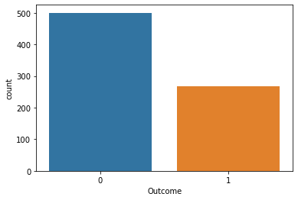
DIABETES DATASET
Total no of hypothesis is 768 and out of which 500 is predicting it to be 1 whether the rest is predicting it to be 0.
Not diabetic
Diabetic
Graph representing the diabetic dataset.

Slide 7
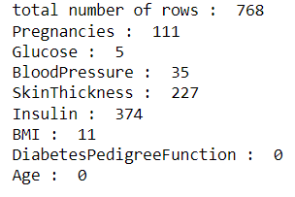
Data pre-processing
Out of 768 hypothesis column of some attribute contain 0 value.
we have replaced that 0 value with mean of that particular column
No of attribute having value as 0.

Slide 8
Correlation
The below fig shows the corelation between the different attribute present in the dataset
On the basis of that we will decide which attribute has the higher effect on the output data.
Here we find out that Glucose concentration has the highest effect on the output dataset and blood pressure has the lowest effect.

Slide 9
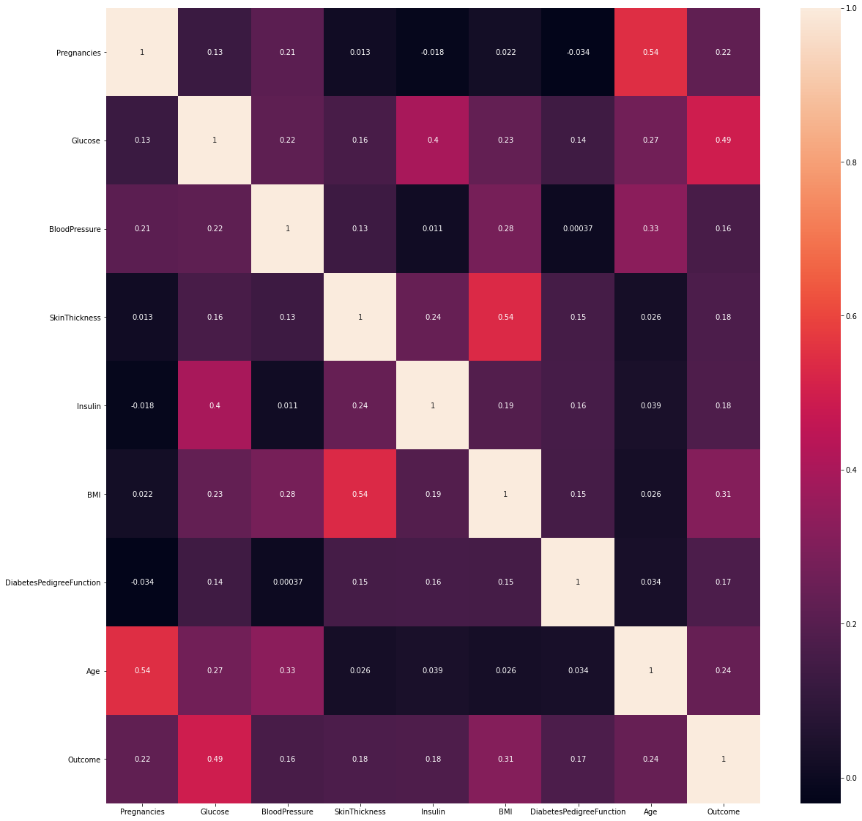
correlation
Correlation between different attribute and class level value.

Slide 10
Balancing the dataset
We will balance the dataset using oversampling under sampling and smoot algorithm.
On balancing the dataset we found different accuracy with using SVM and ANN on normal data and oversampled and under sampled data.
The max accuracy gain is 80.5% using ANN with 100 epoch.

Slide 11
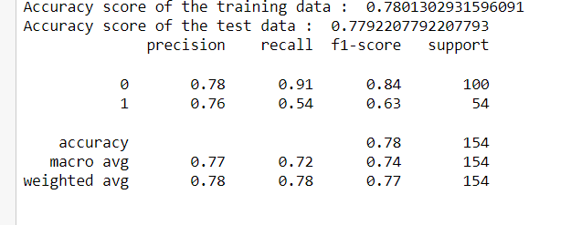
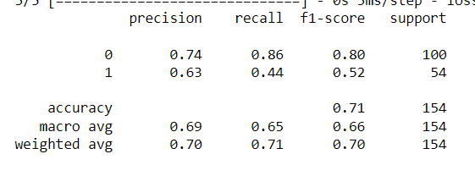
Accuracy analysis on normal data
SVM
ANN

Slide 12
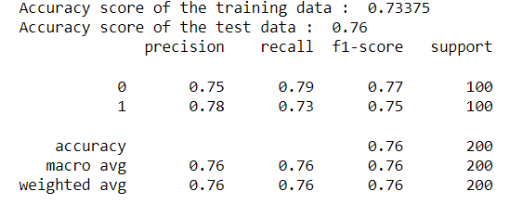
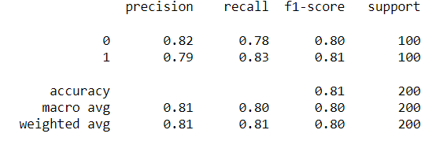
Accuracy analysis on oversampled data
SVM
ANN

Slide 13
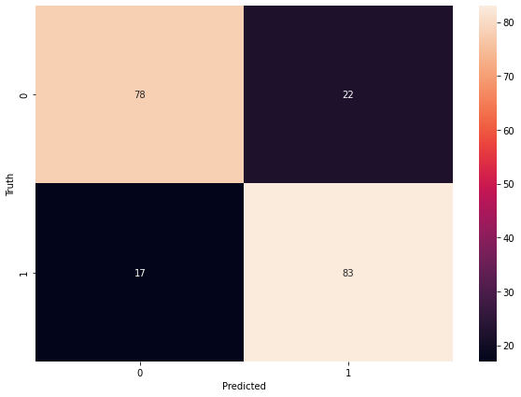
Confusion matrix
We have got an accuracy of 80.5 percent .

